Slide 1
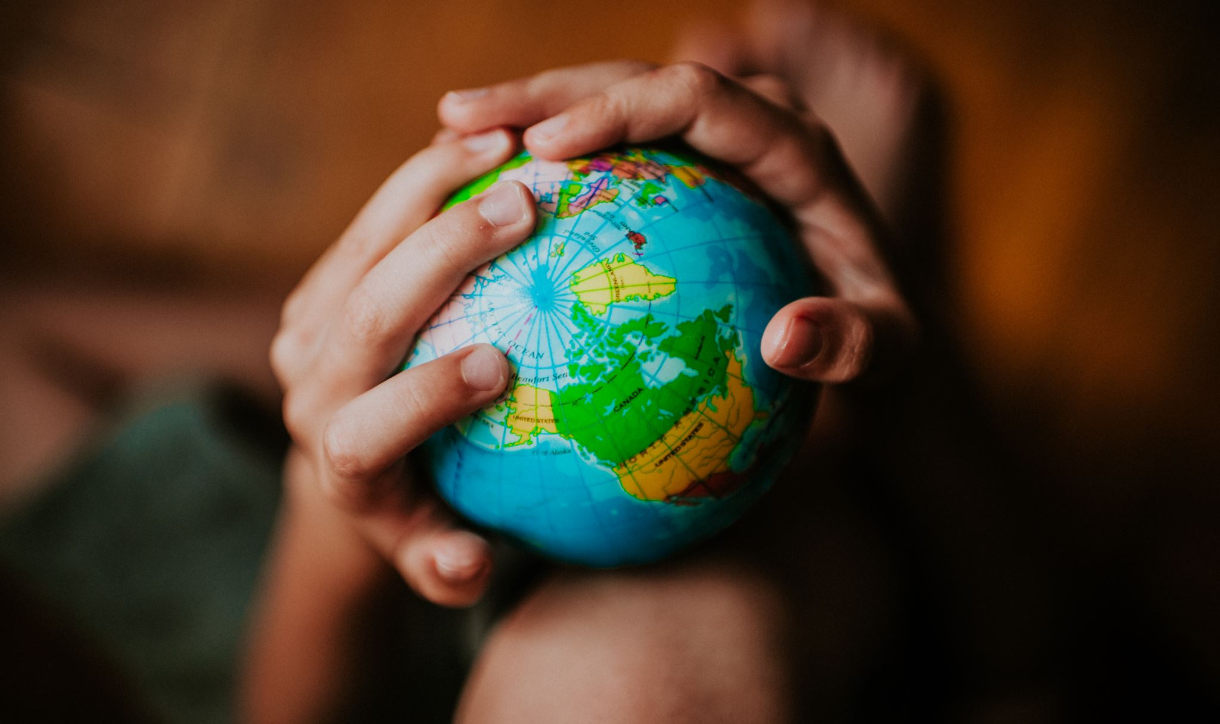
EVERY DROP COUNTS – SAVE WATER
The world is in your hands – we need to take action now to stop severe water shortages in the future. Discover how The Unified Water Label and you can help conserve water

Slide 2
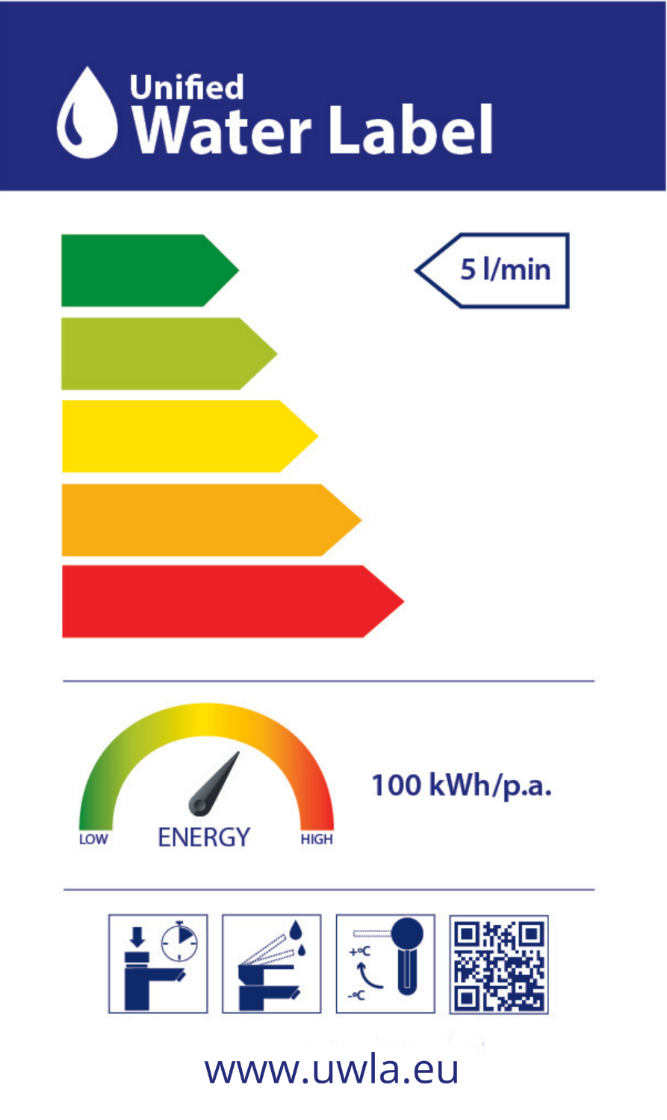
The Unified Water Label
The Unified Water Label is a smart tool that is used to identify water saving products. Each colour on the chart demonstrates the water and energy efficiency of a product.

Slide 3
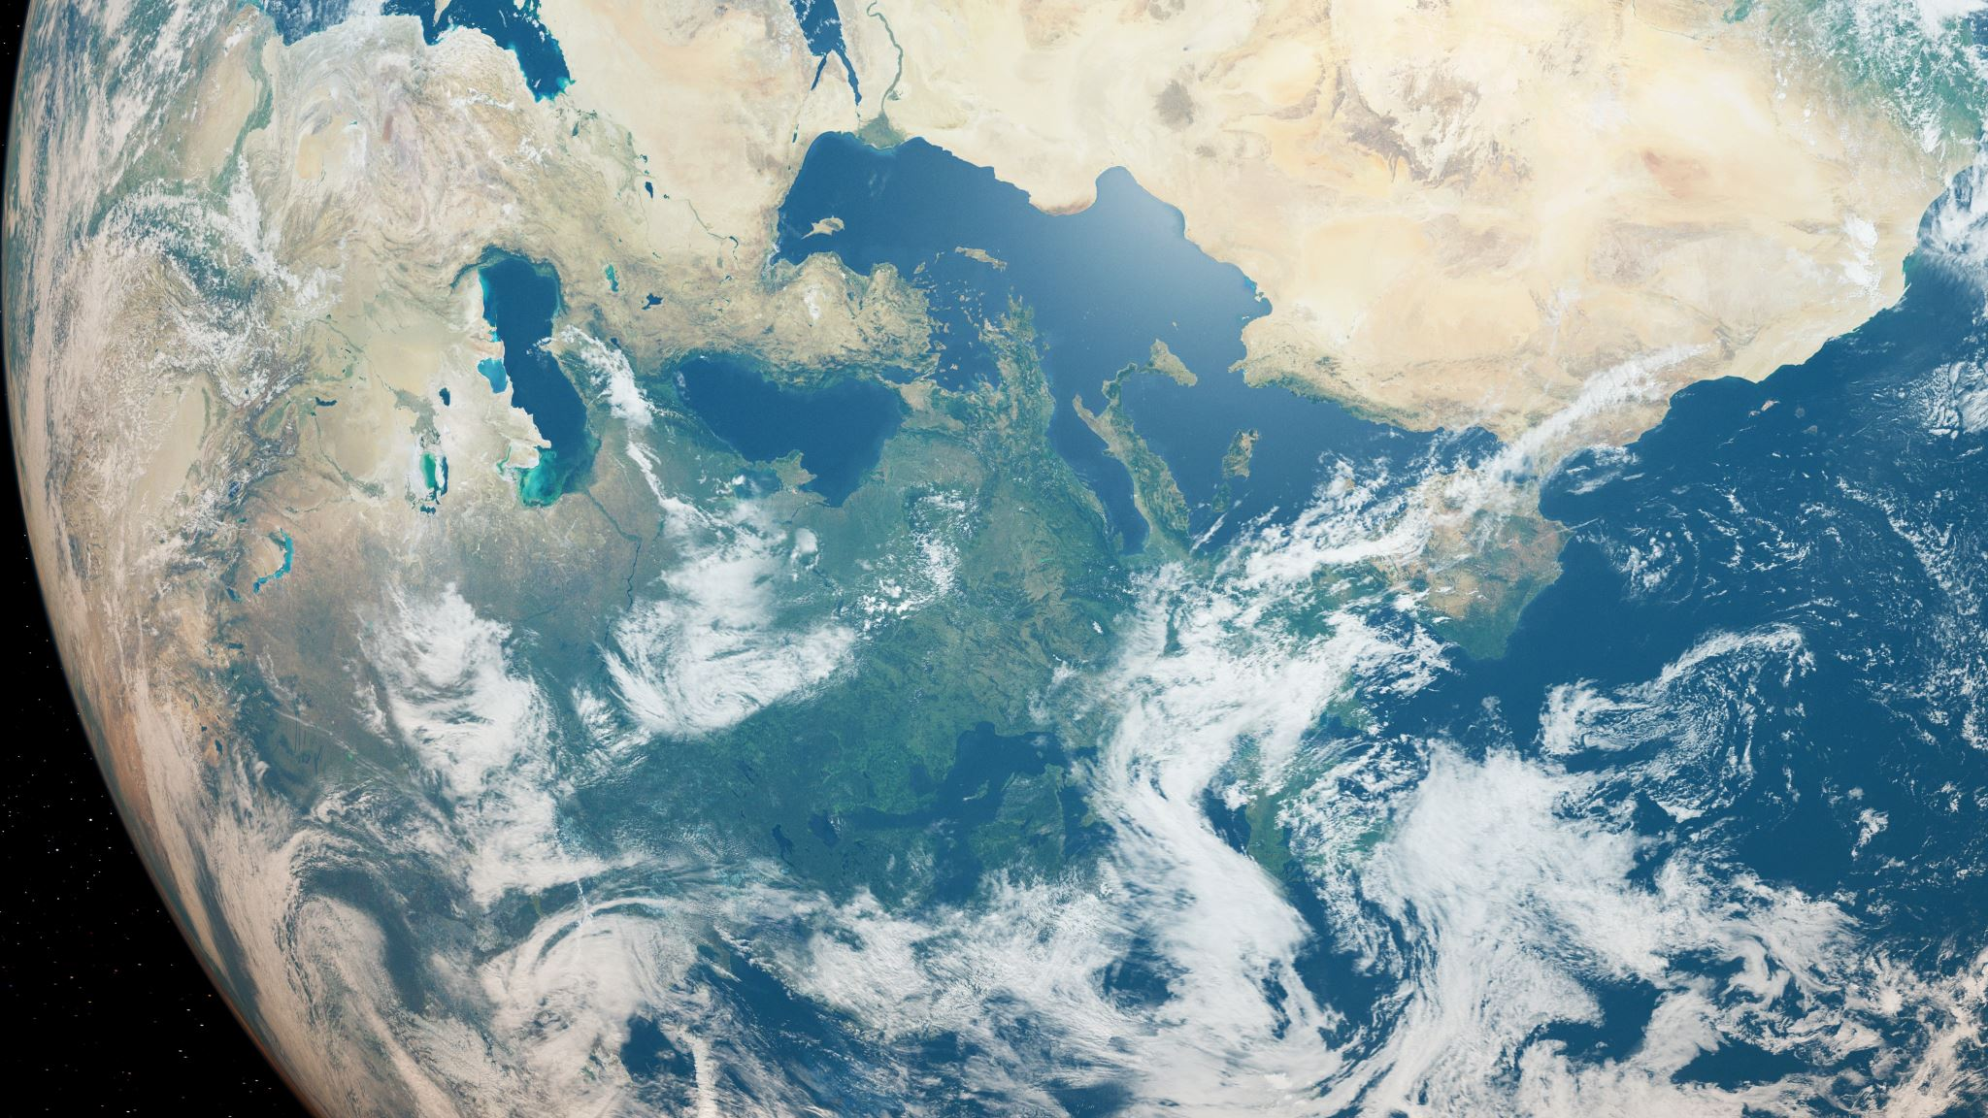
Where does water come from?
70 percent of the Earth's surface is water-covered but only 1 percent of water is fresh and usable. Our water comes from water treatment facilities or from private wells. The water we use is the result of Earth’s water cycle.
The suns heat changes the liquid water in our oceans to a gas called water vapour – this process is called evaporation.
As this water vapour rises higher and higher the cool air of the atmosphere causes the water vapour to turn back into liquid water – creating clouds. This process is called condensation.
The clouds get heavier and full of liquid water – this water then falls from the sky as rain or snow – this process is called precipitation.
Snow and rain then falls into streams and lakes – collection and the process starts all over again.
This process is called ‘The Water Cycle’

Slide 4
Image of the Water Cycle

Slide 5
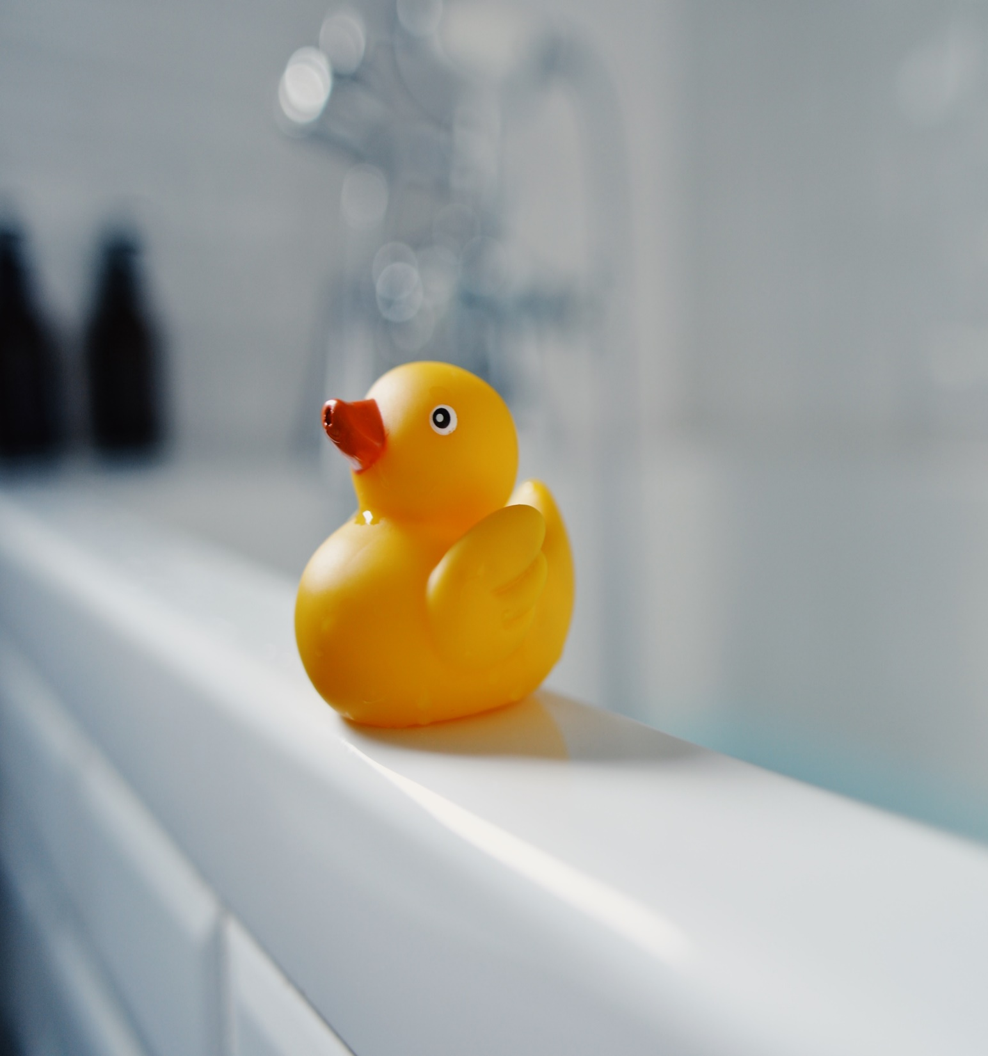
DID YOU KNOW?
One bath uses 80 litres of water! A short shower uses a third of that amount.
SOLUTION – shower more often than a bath and
save the bathwater to water the garden.

Slide 6
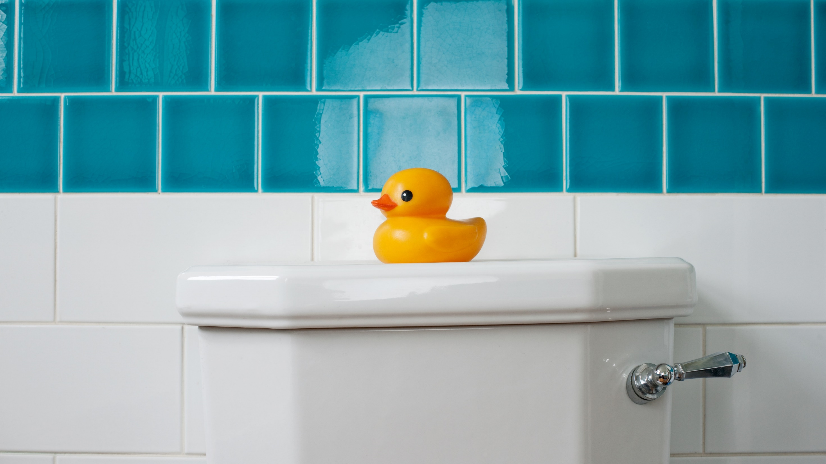
DID YOU KNOW?
That on average every time you flush the toilet 2.5 litres of water is used
SOLUTION: Do not flush items down the toilet like tissues or other types of waste.

Slide 7
Did you know…
That every time you flush the toilet 2.5 litres of water is used
SOLUTION: Some water –saving bag devices can be used in the cistern to save water

Slide 8
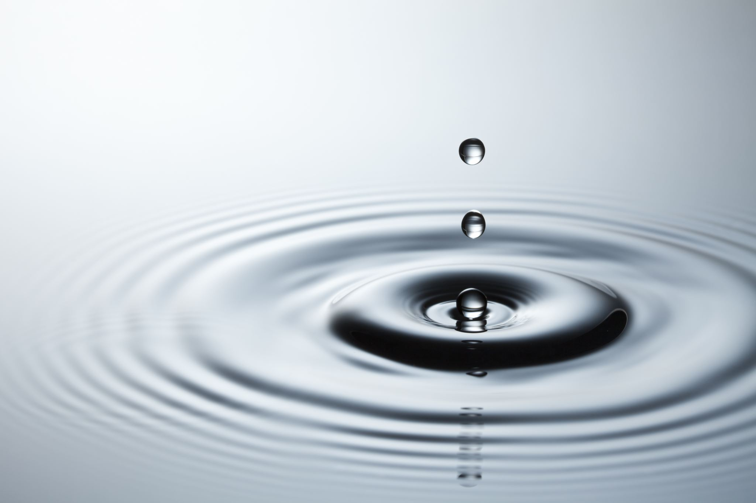
Did you know...
Clean water is wasted down the plughole - a dripping tap wastes up to 25 litres of water a day.
Solution: Turning off the tap whilst brushing your teeth can save up to 6 litres of water per minute.

Slide 9
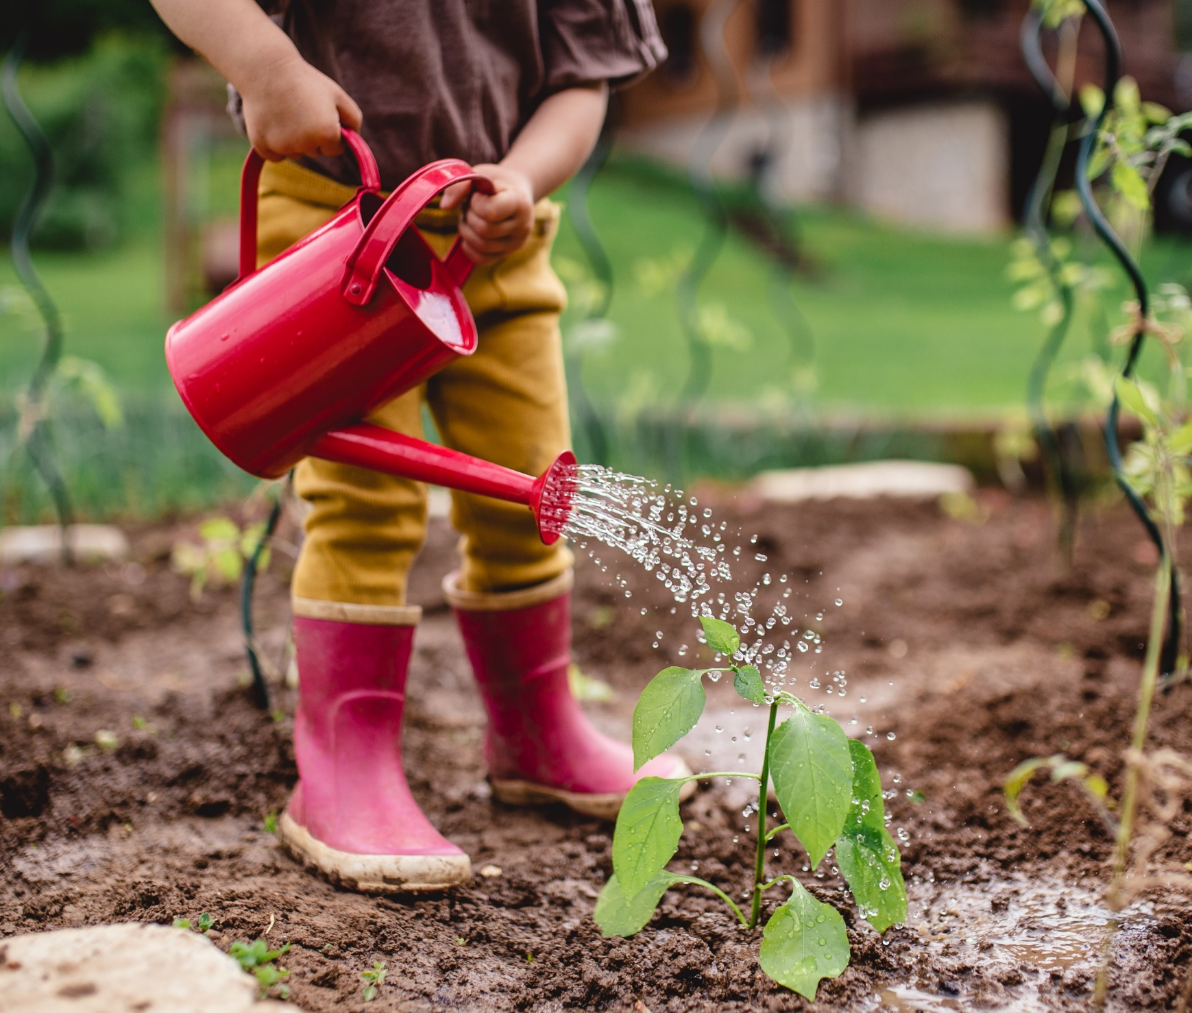
Did you know …
Water is wasted outside too. A garden sprinkler or hose can use up to 600 litres of water in one hour! Washing a car using a hosepipe can use around 180 litres of water.
Solution: Collect rainwater in a water butt to water the plants.
If you clean the family car with water in a bucket you would only use around twenty litres of water.

Slide 10
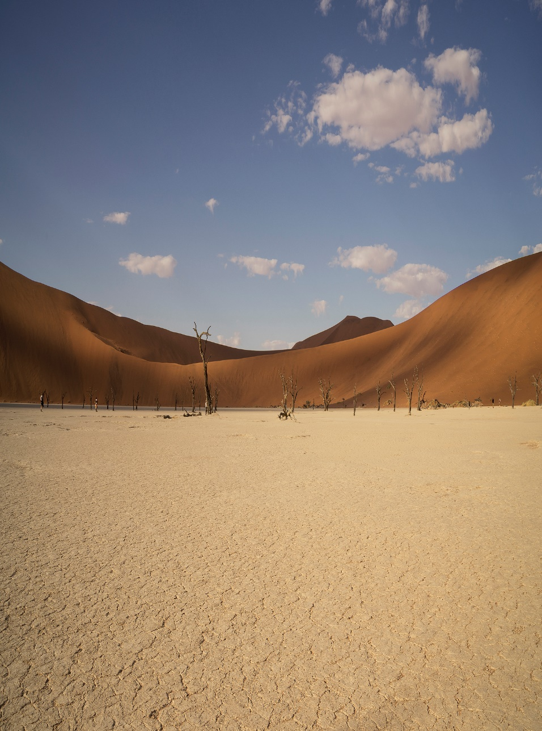
Did you know …
In many countries water is very scarce and precious. This is because they have very little rainfall. This causes droughts, the ground dries out and crops cannot be grown.
A few villages may have a well where they can obtain clean drinking water, but in other villages children often have to walk many miles to find clean water. Drinking dirty water can make children and adults very ill.

Slide 11
Did you know…
There are many more ways in which individuals and schools can help save water – to download a fun saving water resource pack visit www.uwla.eu
For information on how to launch a ‘Save Our Water Competition’ please contact Schememanager@UWLA.eu

